Slide 1








1 case
New Build
Wait for Installer \ Build
Wait for Offline
Install Version
Configure and Start System
Import Recipe
Execute Recipe
Compare CST using BC4
1 hr
SQA Rules!
15 min
1 hr
2 hr
4 hr / build
1 hr / case
2 min
30 min
2 min
Manual Testing
5 min

Slide 2

~30 cases in 1 hour!
Wait for Installer \ Build
Wait for Offline
Install Version
Configure and Start System
Import Recipe
Execute Recipe
Compare CST using BC4
New Build
No need
SQA Rules!
TBD
Automatic
No need
~1 hour
¼ h / build
~40 min
~40 min/ ~30 cases
15 min in Docker/version
Automated Testing
Automatic
Automatic

Slide 3
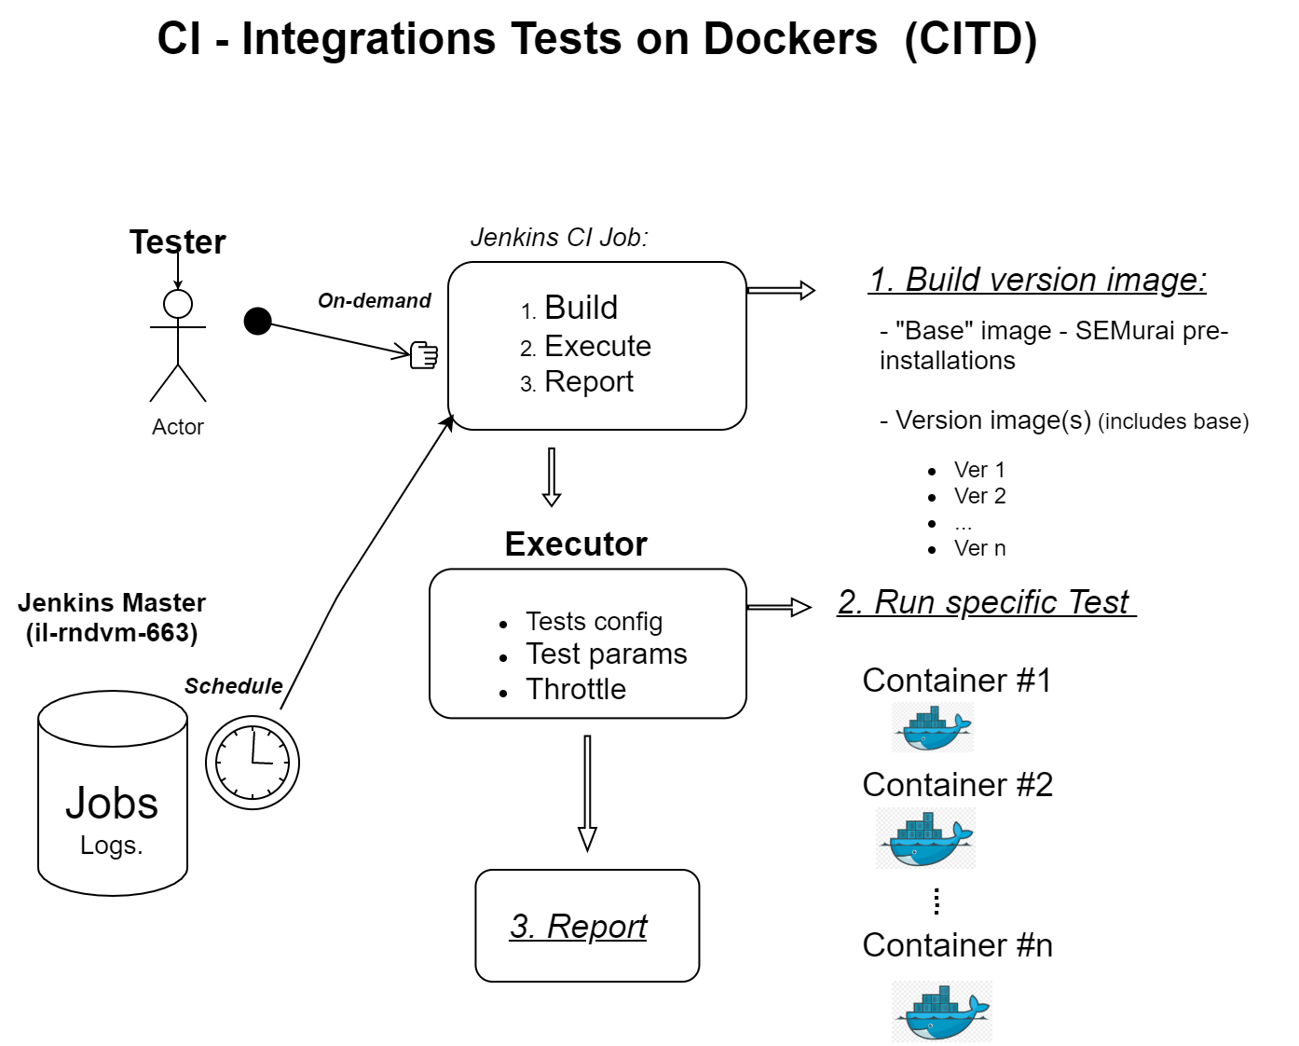
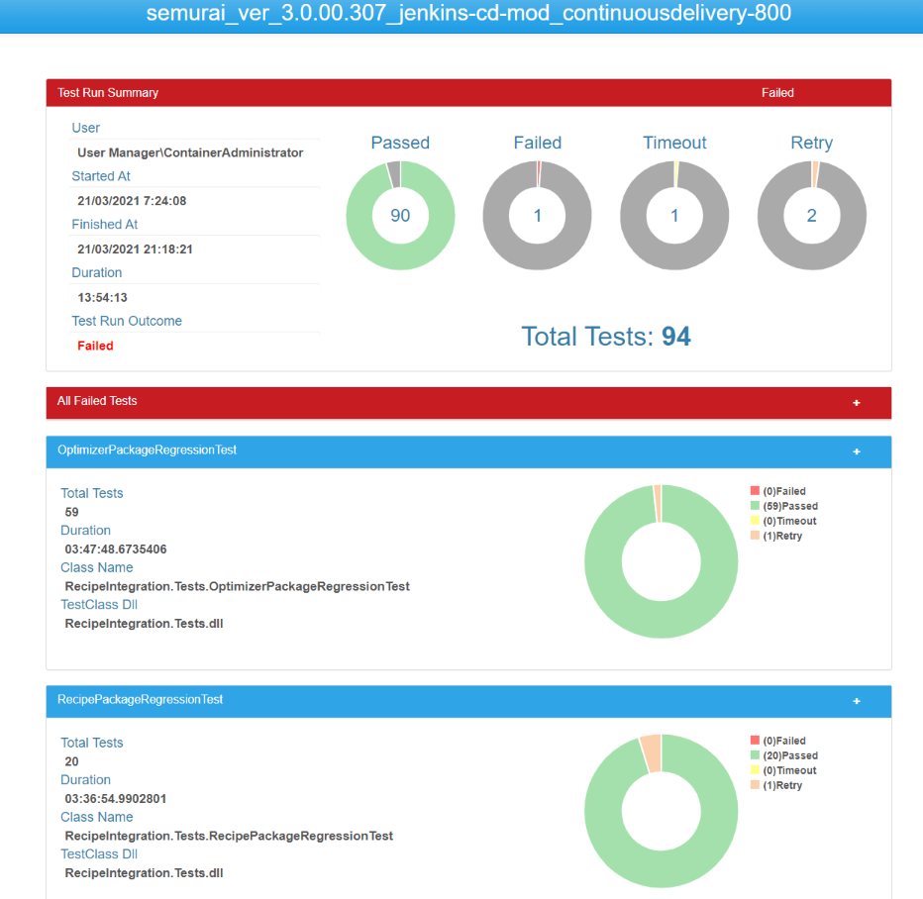

Slide 4
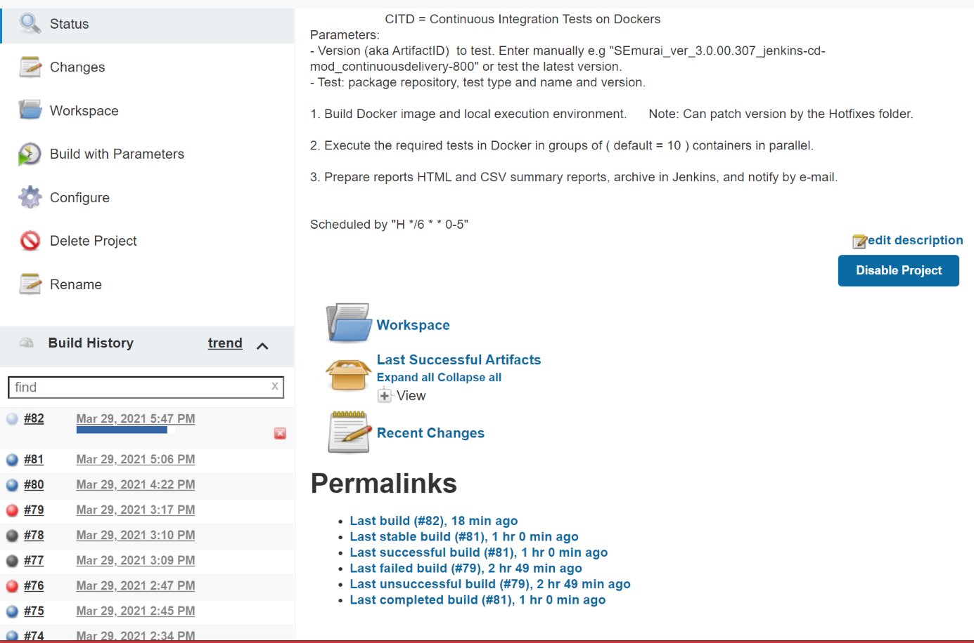





Automation Job
Scheduled job default parameters:
Latest Version (in shared folder)
All tests in "NightRun" repository
Job Process:
Build
Execute
Report

Slide 5
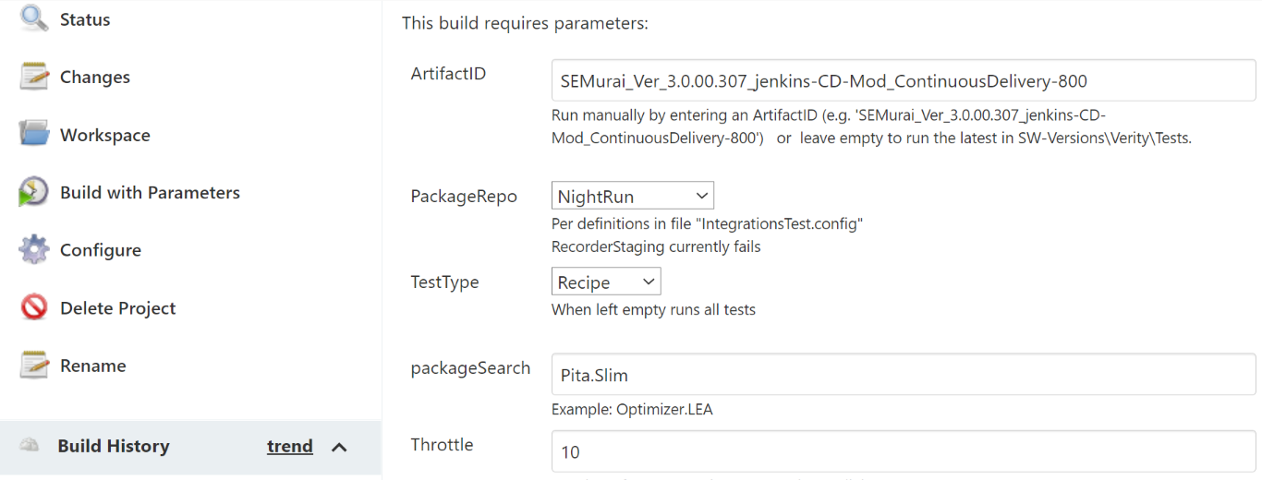







Run job manually on Docker(s)
ArtifactID:
Verity version to test
PackageSearch:
Run a specific test.
Throttle: # of tests to run in parallel, each in a separate Docker container

Slide 6

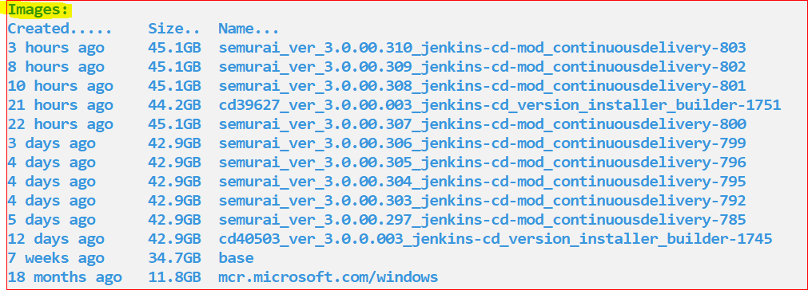
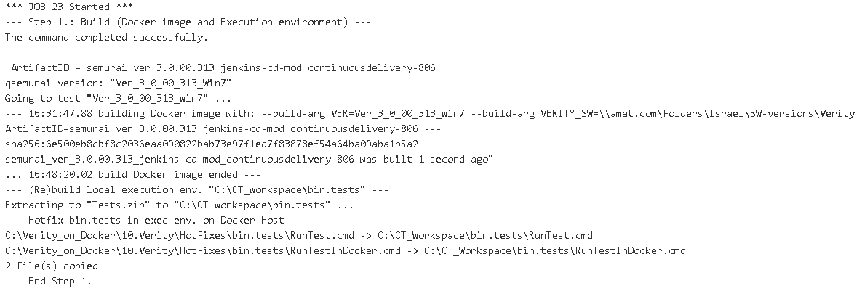
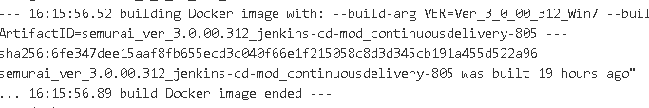







1. Build step
Command: C:\> Docker images ls
SEMurai pre-installations
Build new image (15 min)
Re-use existing image (1s)

Slide 7
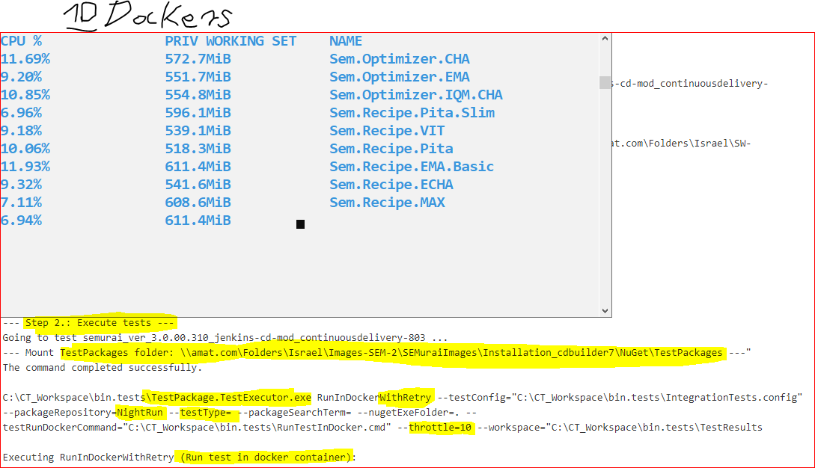

2. Execute tests in parallel (throttle)
C:\> Docker stats

Slide 8
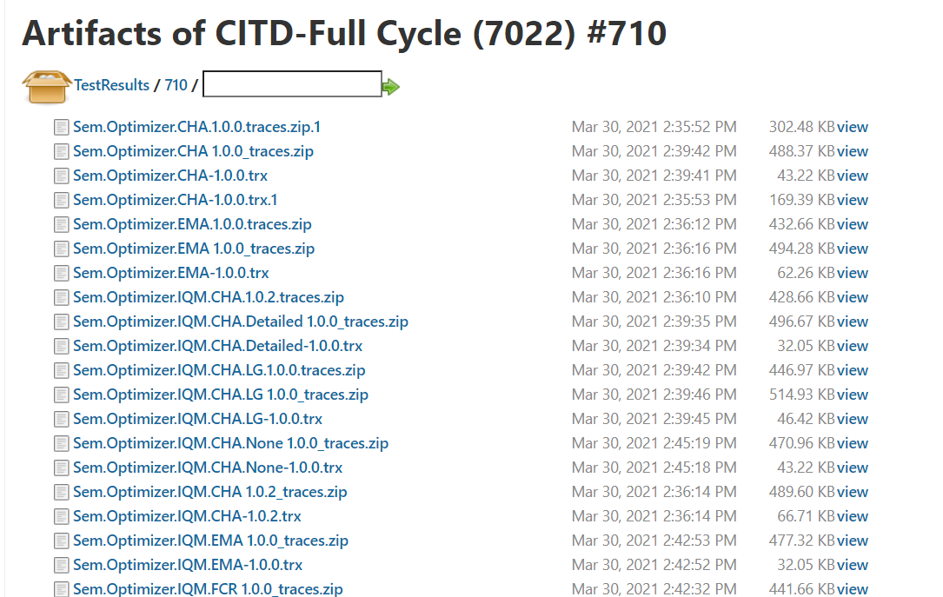



3. Reports #1 – tests traces as job Artifacts Quick summary in job Console
Executing ProcessTrx (Process trx files, creates csv report, can rename test name to package id name): CSV file saved to C:\CT_Workspace\bin.tests\TestResults\91\semurai_ver_3.0.00.322_jenkins-cd-mod_continuousdelivery-818.csv Executing ProcessTrx (Process trx files, creates csv report, can rename test name to package id name): CSV file saved to C:\CT_Workspace\bin.tests\TestResults\ResultSummary.csv Quick facts on all tests: # of tests: 692 Passed: 680 Failed: 12 Did not reach Ready state: 0 Success rate: 98 % Reports completed - 91 - Good job! Versions reports: \\vm-devops-7041\CT_Workspace\bin.tests\TestResults\Reports *** JOB 91 Ended *** Archiving artifacts Finished: SUCCESS

Slide 9
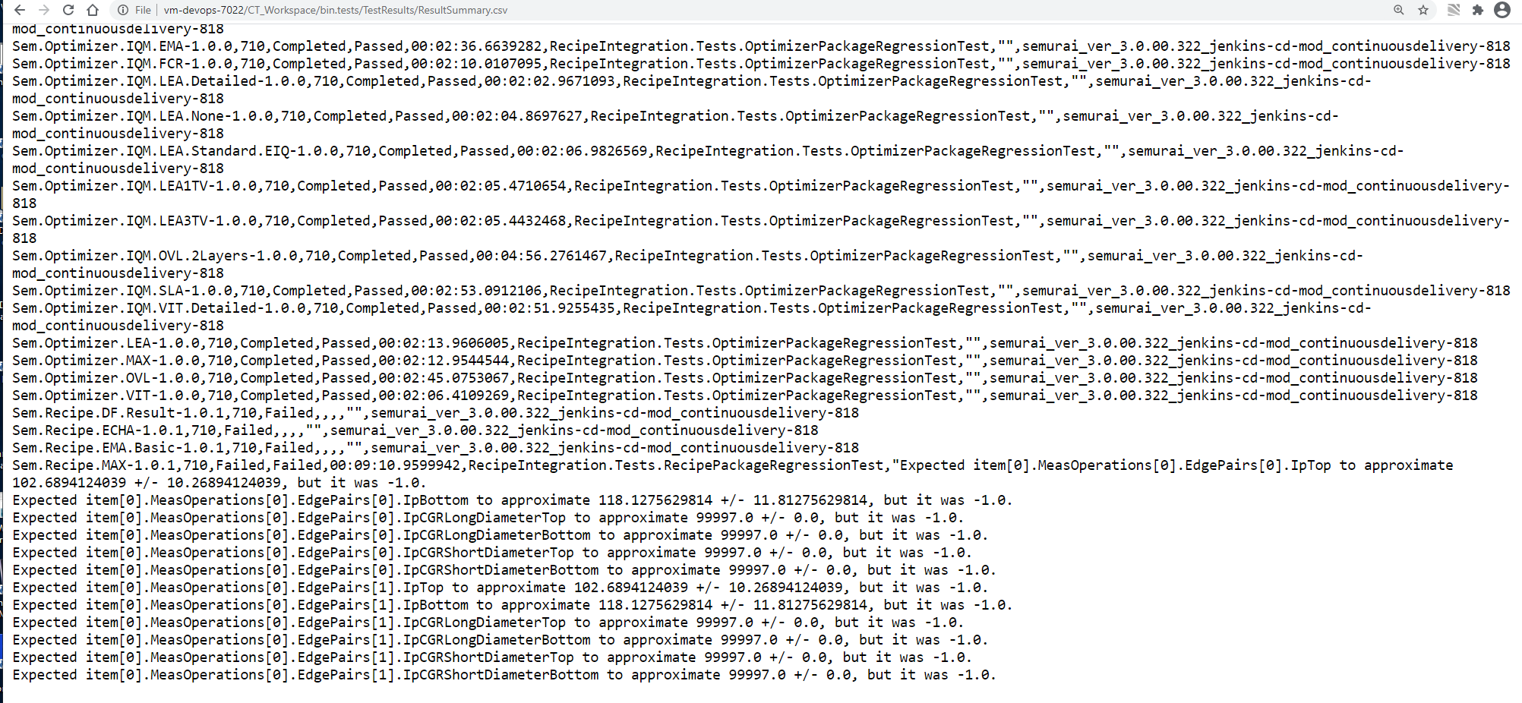










3. Reports #2 – Tests results summary csv file

Slide 10
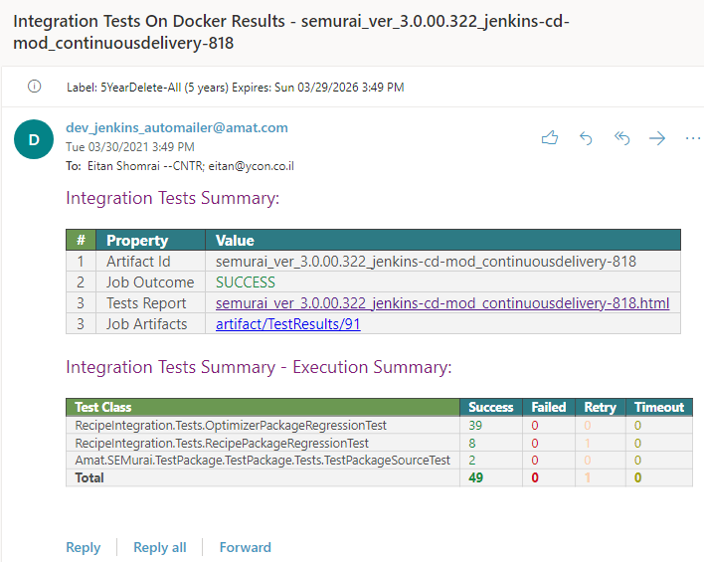
3. Reports #3 – E-mail

Slide 11
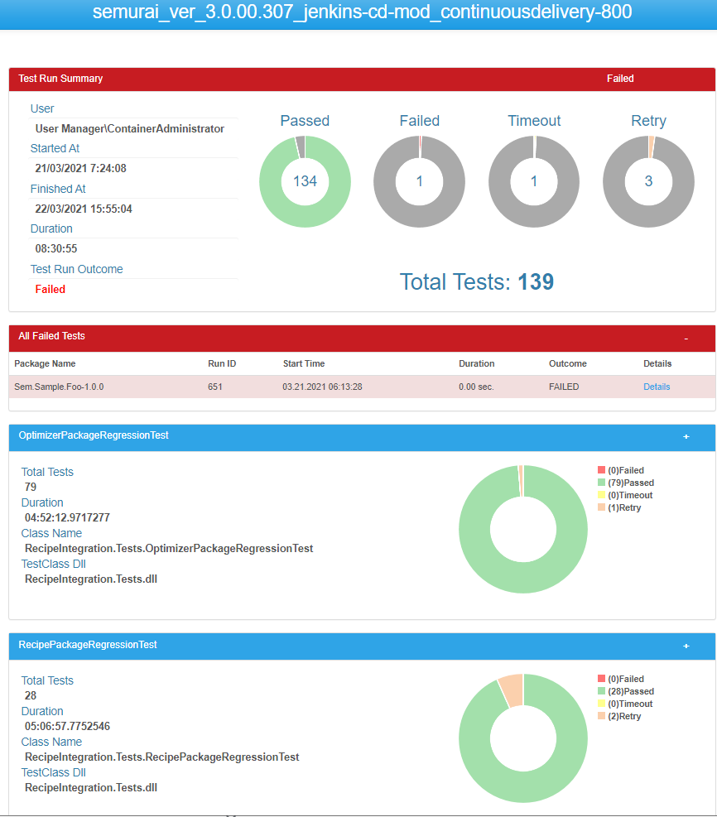
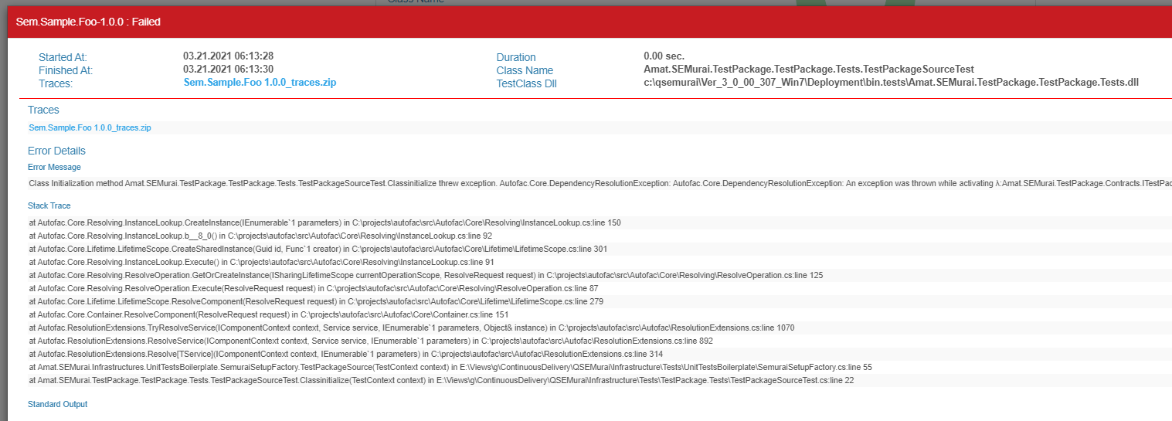
3. Reports #4 – Artifact version reports

Slide 12

Links to Jenkins jobs
Jenkins CI - DevOps-7022 node
Jenkins CI - DevOps-7041 node

Slide 13






